Slide 1

AMRUTVAHINI COLLEGE OF ENGINEERING,
SANGAMNER
DEPARTMENT OF COMPUTER ENGINEERING
2024-2025
Presentation
On
“BlockShare - Blockchain Based Secure Data Sharing Platform”
BE Computer Engineering
BY
Group Id- B-06
Mr. Abhijit Rajaram Sahane (4228)
Mr. Shinde Rohit Nivrutti (4240)
Mr. Sayyad Mohammadsaani Shahid (4234)
Mr. Kankate Sairaj Chandrakant (4157)
Guided by: Project Coordinator: H.O.D
Ms. K. U. Rahane Dr. D. R. Patil Dr. S. K. Sonkar

Slide 2
System Architecture

Slide 3
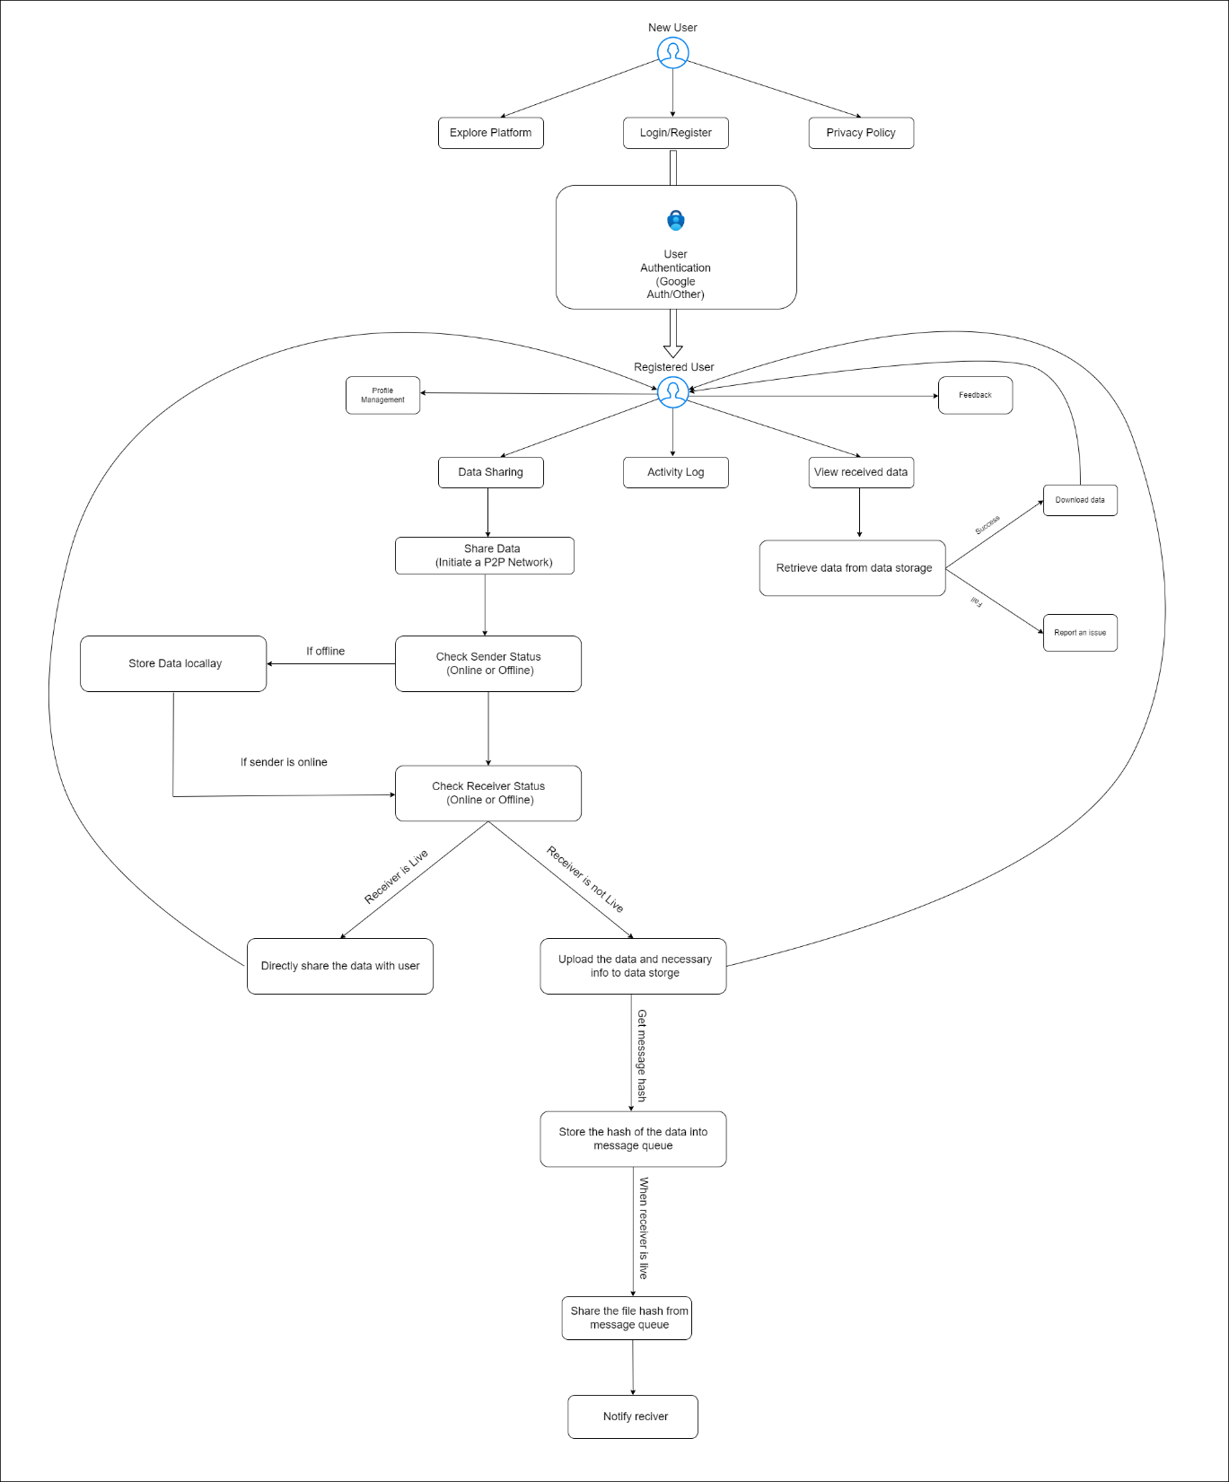

Slide 4
DFD level 0

Slide 5
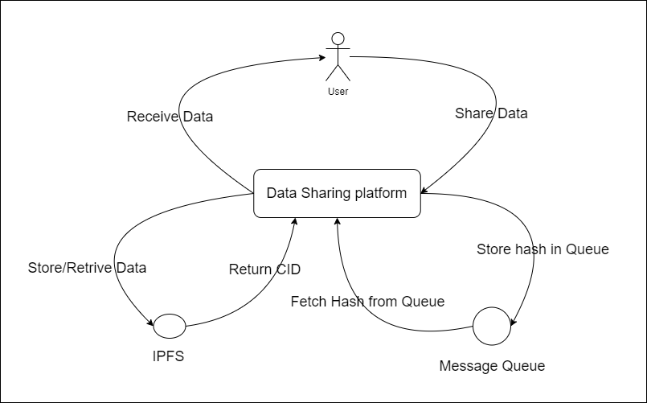

Slide 6
DFD level 1

Slide 7
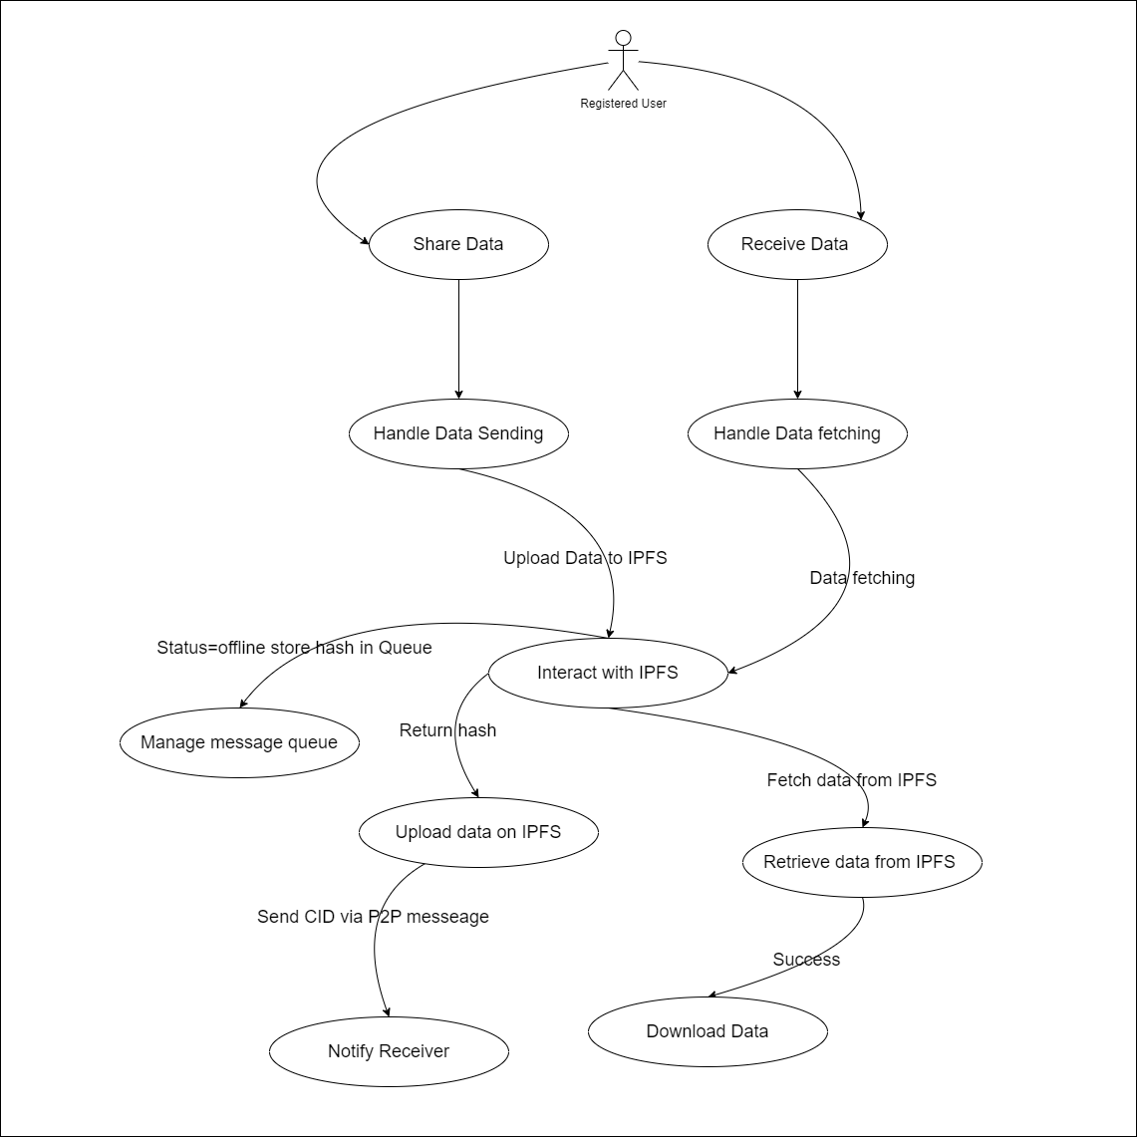

Slide 8
Class Diagram

Slide 9
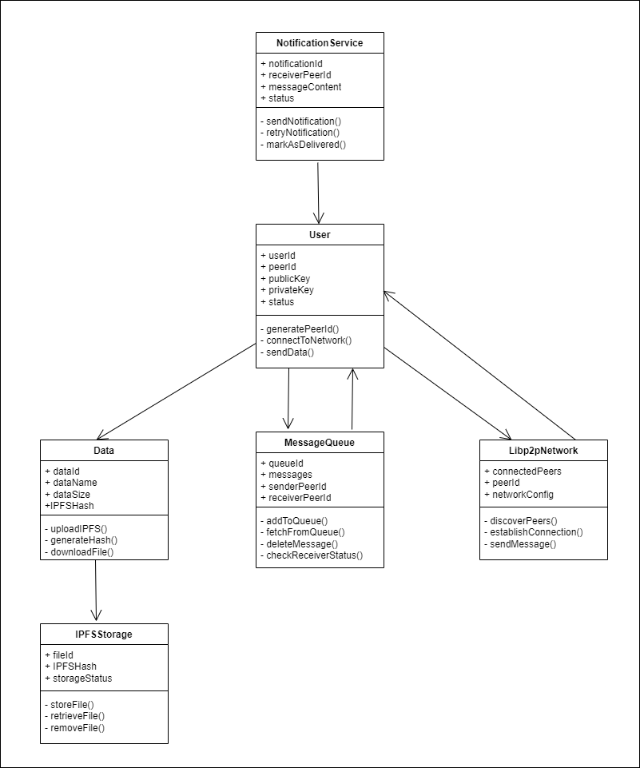

Slide 10
Object Diagram

Slide 11
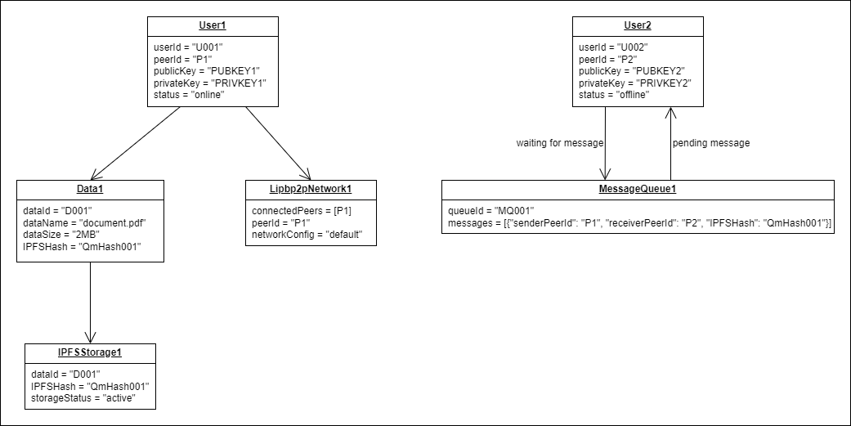

Slide 12
Use Case Diagram

Slide 13
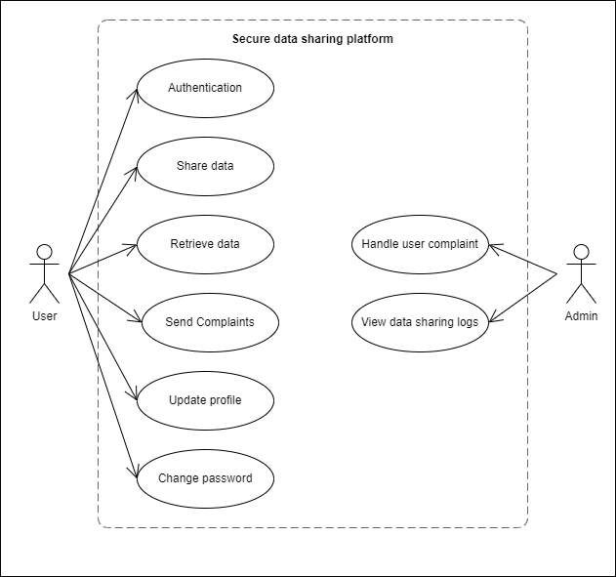

Slide 14
Sequence Diagram

Slide 15
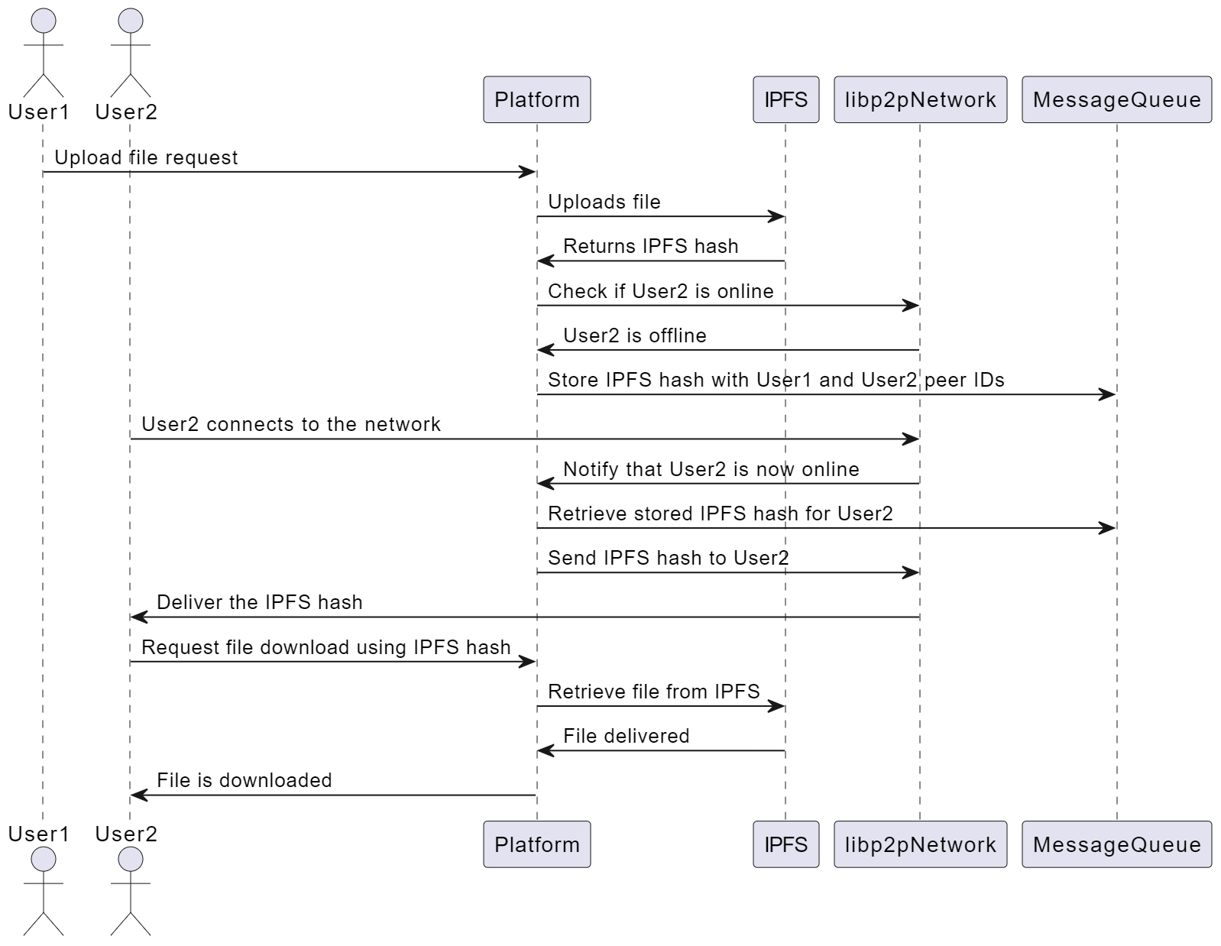

Slide 16
Activity Diagram

Slide 17
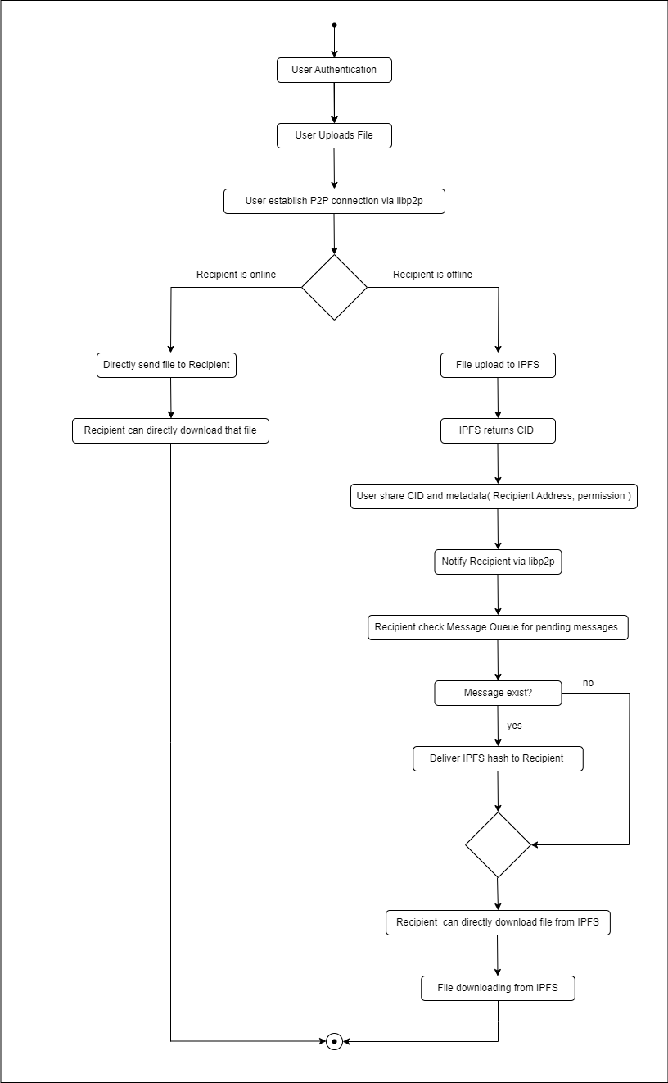

Slide 18
Thank You

